Slide 1

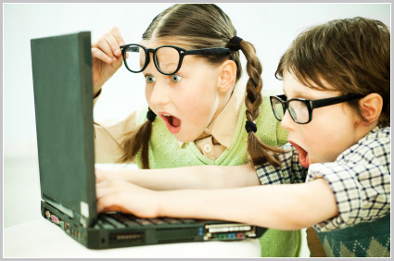
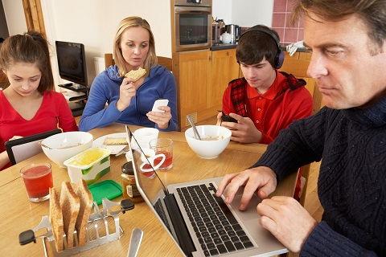
Modern lifestyle

Slide 2
Modern lifestyle
A way of living of individual, families and societies, which they manifest in coping with their physical, psychological, social, and economic environment on a day-to-day basis. Lifestyle is expressed in both work and leisure behaviour patterns and (on an individual basis) in activities, attitudes, interests, opinion, values, and allocation of income. It also reflects people's self image or self concept; the way they see themselves and believe they are seen by the others. Lifestyle is a composite of motivations, needs, and wants and is influenced by factors such as culture, family, reference groups, and social class.

Slide 3
Modern life style has a number of advantages which includes easing peoples life, saving hundreds of peoples lives by the new development of medicine and vaccines. On the other hand different modern life style patterns have negative effects on health physically, psychologically, and socially. One of these modern ways of living is the high intake of fast foods. This is due to specific reasons such as the short time specified for eating and choosing healthy food. Lack of physical activity combination with fast foods leads to bad effects on the heart's health. Use of high technology machines is another way of modernity. Although use of these machines has helped in saving the time to do a lot of tasks, the wrong use of them will indirectly affect health.

Slide 4
Another point is the advanced transportation which reduces the time needed to travel and made travelling an enjoyable time. Last, is the use of computers and internet in the communication, transfer of information, and entertainment as well. Altogether will constitute the elements of a sedentary life style. That means, high fatty foods intake and lack of physical activity. Which both are caused by fast foods, depending on high technology machines and transportation, and sitting long hours in front of the computer.

Slide 5
Modern life style increases the risk of obesity. Consequently, leading to diabetes, heart diseases, and cancers. Pollution caused by the machines and advanced transportation causes different respiratory diseases. Furthermore, it leads to atopic diseases which are group of hereditary diseases contributing to allergies and asthma. Psychologically, persons are prone to increased stress level and depression. Social isolation will occurs due to spending long time on computer and internet.

Slide 6
Problems of Modern Life-Style
Tension - physical, mental, emotional
Health problems - physical, mental and emotional diseases (including psychosomatic disorders)
Ecological pollution/rupture in ozone layer
Disturbed family relations
Violence and cruelty
Corruption / dishonesty / immorality
Drug-addiction
Neglect of law & order and ethical, moral and social discipline
Armaments/nuclear weapons (militarism)
Exploitation

Slide 7
Advantage of modern lifestyle
The development of technology make it easier for people to communicate, to travel, to work etc.
The computers & mobile phones makes it easier for us to communicate all over the world.
Education has developed with the use of internet.

Slide 8
Disadvantage of modern lifestyle
The culture and tradition is fading off.
The traditional food, clothes etc are slipping off from our minds.
Technology also has reduced the interaction with family members.
The environmental damages like air pollution, water pollution and noise pollution.

Slide 9
Hypokinetic diseases

Slide 10
Hypokinetic diseases are conditions that occur from a sedentary lifestyle. "hypo" means less and "kinetic" means movement. So Hypokinetic diseases are caused due to lack of physical activity.
Hypokinetic diseases are conditions related to inactivity or low levels of habitual activity. It describes many of the diseases and conditions associated with inactivity and poor fitness such as those conditions outlined in "Physical Activity and Health. Health problems brought about by lack of exercise have increased. This can be accounted for, to some extent by the change from jobs needing physical effort to more sedentary occupations (e.g. office jobs).

Slide 11
Following are the main Hypokinetic diseases:
Cardiovascular disease
Some forms of cancer
Back problems
Obesity
Type 2 diabetes
Osteoporosis
Mental health problems
high blood pressure
high cholesterol

Slide 12
PREVENTION
AND
MANAGEMENT
OF
HYPOKINETIC DISEASES

Slide 13
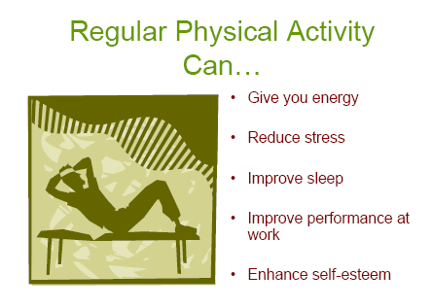
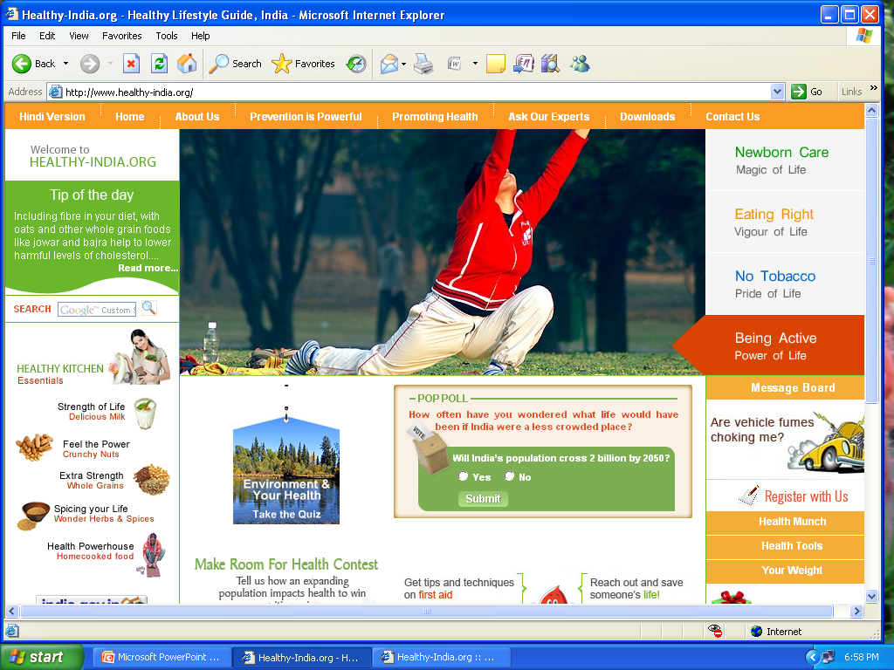
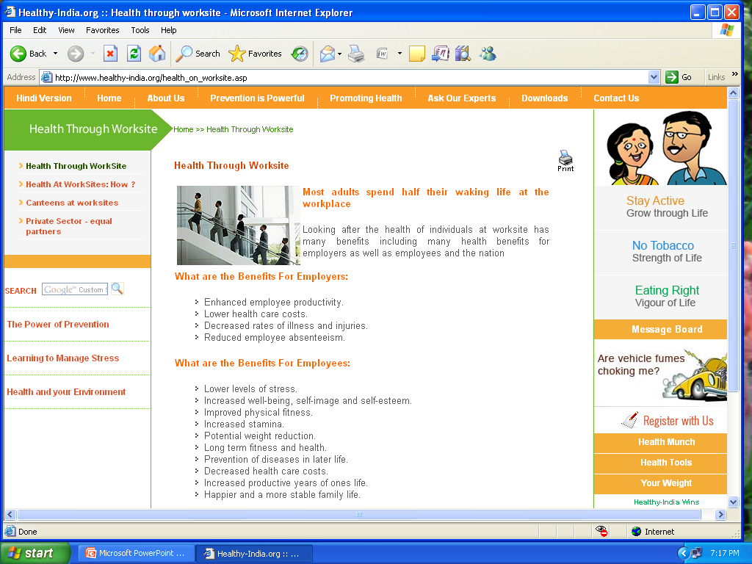
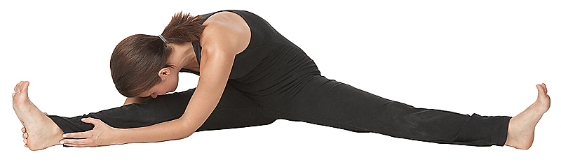

Slide 14
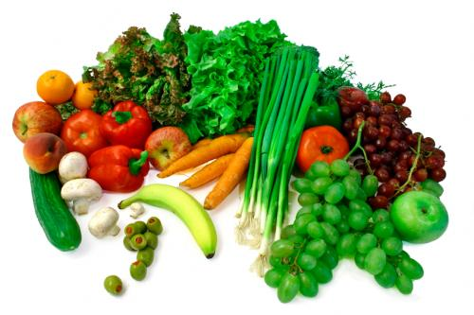
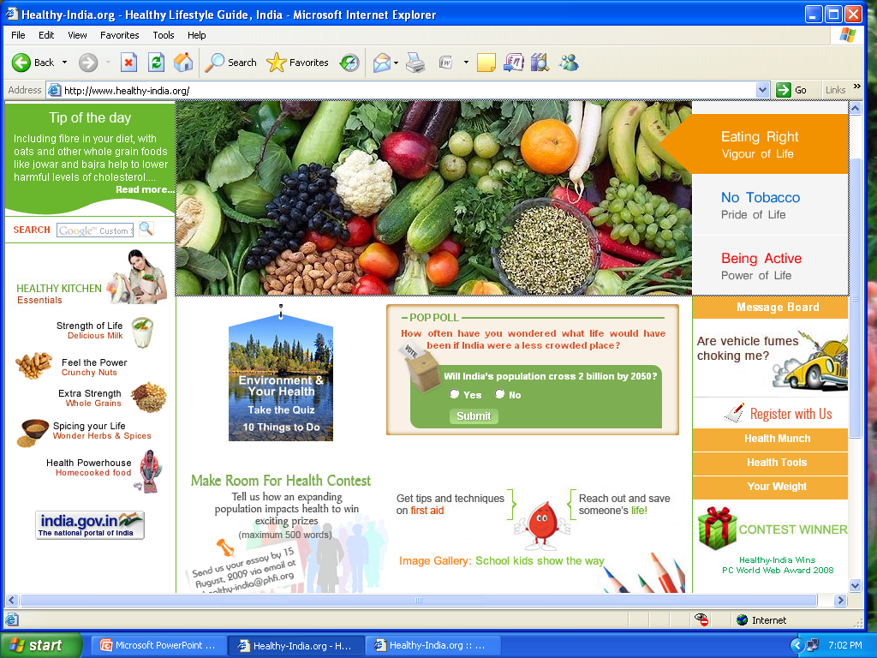
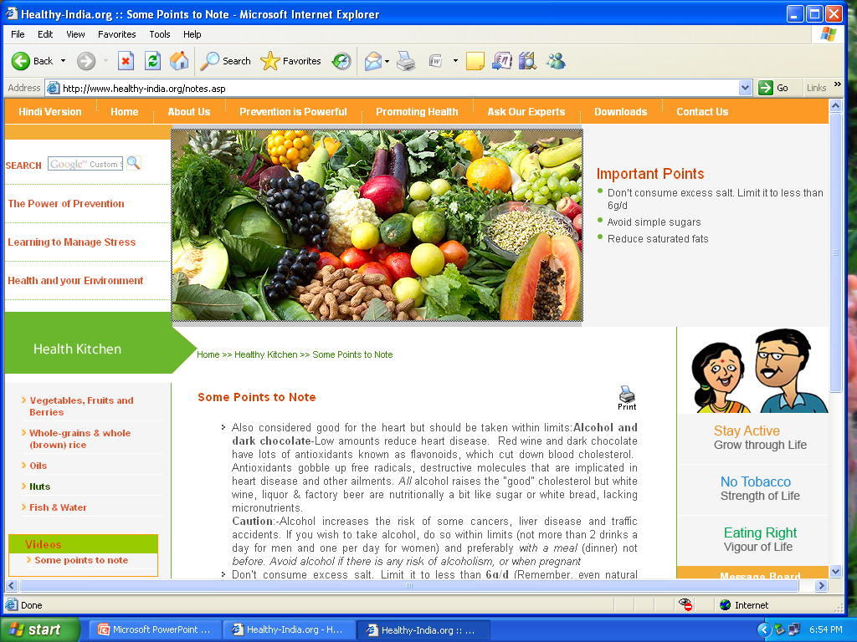
Prevention
Consume a diet Rich in vegetables and fruit.
Take variety of vegetables and fruits (all coloured)
Avoid eating more high calorie fruits (mango, banana, jack fruit etc)
Whole fruit is better than fruit juice because it contains fibre
Whatever is green reduces fat and blood sugar
Sweet, sour and salty increases fat and blood sugar

Slide 15
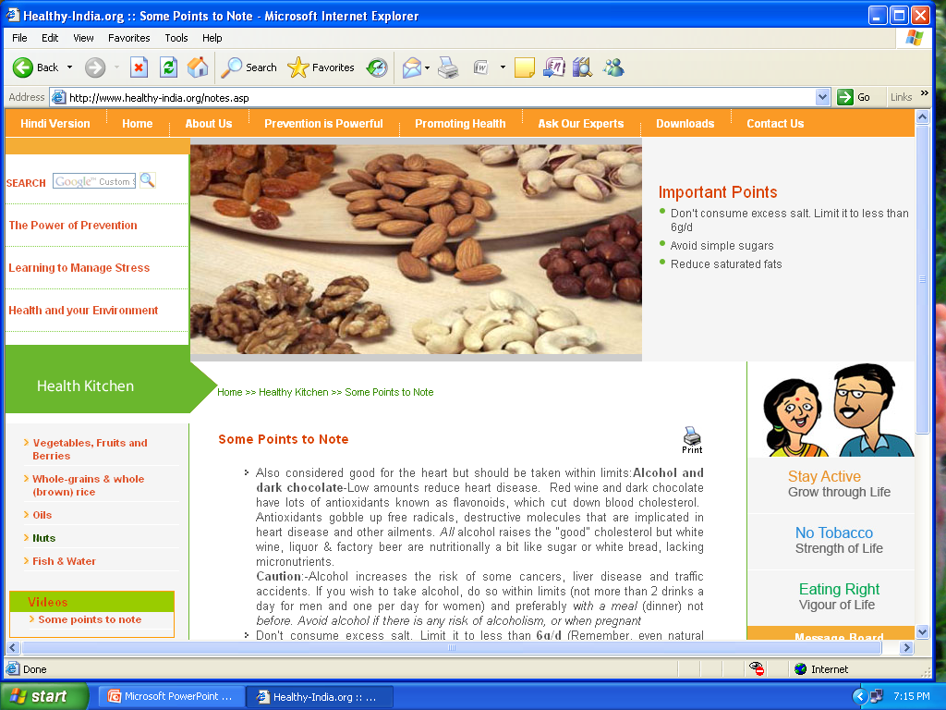
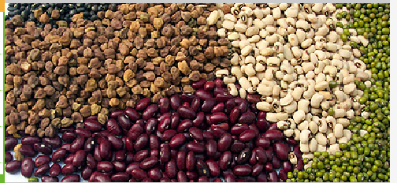
Choose whole-grain, high fiber food
Fiber reduces LDL and risk of CVD
Consume Fish, especially oily fish at least twice a week
Avoid taking egg yolk which is high in cholesterol
Avoid saturated fat (animal fat and ghee, butter, malai etc.)
Use toned milk

Slide 16

Minimise intake of sugar and sugar added food (glucose, sucrose, fructose etc). Sugar has hollow calorie and it is called sweet poison.
Eat Multi-grain bread/roti
Use oil in limited quantity and in variety
Prepare food with little or no salt
Minimise animal protein
Stop or minimize alcohol intake. Alcohol has also hollow calorie.

Slide 17

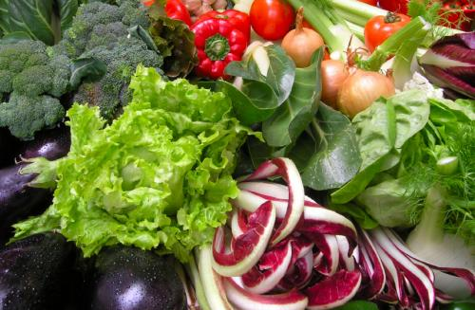
Drink sufficient water : 3 to 3.5 ltr
Use boiling, roasting, steaming, baking for cooking and avoid frying.
Take medicine only if required and prescribed by doctor
Don’t take pain killer unnecessarily
Trust on internal medicine factory of the body
Use Tulsi-tea, lemon juice, amla juice, coconut water etc
Maintain PH value

Slide 18
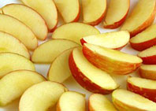
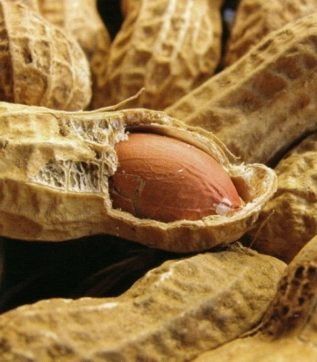
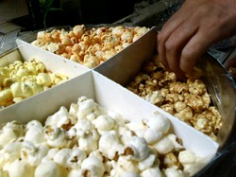
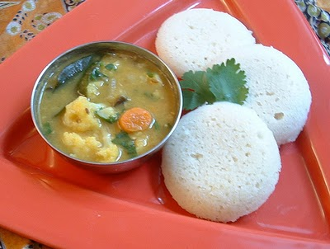
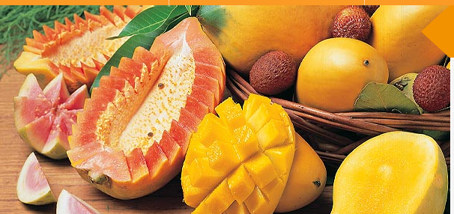
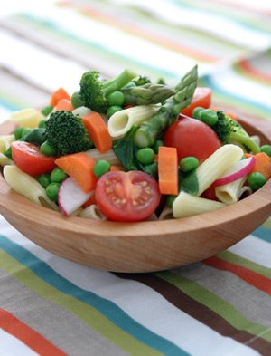
Healthy Food
Fruits
Roasted Cereals like gram, peanuts, pulses etc.
Sprouted cereals
Puffed rice
Chhole / Ghugni
Butter milk (mattha)
Pop corn /Bhutta
Salad
Skimmed milk
Idly & sambhar
Litty & bharta
Chira pulao
Whole wheat biscuit
Nuts (without salt)

